Slide 1

Karlapudi yaswanth chowdary SRM university AP AP22110010104 2022-2026
.

Slide 2
Project title:- Portfolio site creation using html,css,javascript problem statement:-
As we know in the earlier days if we applied for a job for the resume we had to carry all the required hard copies. In these days we could create a portfolio site where our all the required details will be available. And we can share the portfolio to them which would be more professional and easy.

Slide 3
Agenda
The agenda is simple that is to create a portfolio which includes all our details.
We use vs code to do this. We use 3 components in vs code to perform this.
Html:- Html is used to develop the whole body we include all the info.
Css:- Css is used to design the whole page.
Java script:- We use js to make the portfolio interactive.
These are the languages we use to develop the portfolio.

Slide 4
Project overview
We are creating a portfolio site where we include all the possible information that one needs to know about us. We include about our studies, about us, contact information etc.
We will do this by using html(hypertext markup language) we code all our details.
And using css we will make the portfolio to look good and beautiful to look.
Using javascript we’ll make the portfolio interactive. This is a brief overview about the project.

Slide 5
Who are the end users of this project?
End users of this project(portfolio) are many other students who are seeking for job opportunities this is best way to expose to different plat forms, different IT sectors, different organizations, many companies are the end users of this project.

Slide 6
Solution and its value proposition
We used vs code and in vs code we used html, css, javascript.
Using html we can structure the whole body. We give our information here. And we can make the website look good by adding all the required css. We use javascript to make the page interactive.s we use above mentioned to get our required portfolio.

Slide 7
customization
This portfolio has been customized as per my needs which will be used for interview purposes
Designed a custom color scheme
Different elements have different properties.

Slide 8
Modeling
We have used table layout for organized information presentation.
Header and footer are used
Html is used for structure designing , css for styling, java script for interactive features.

Slide 9
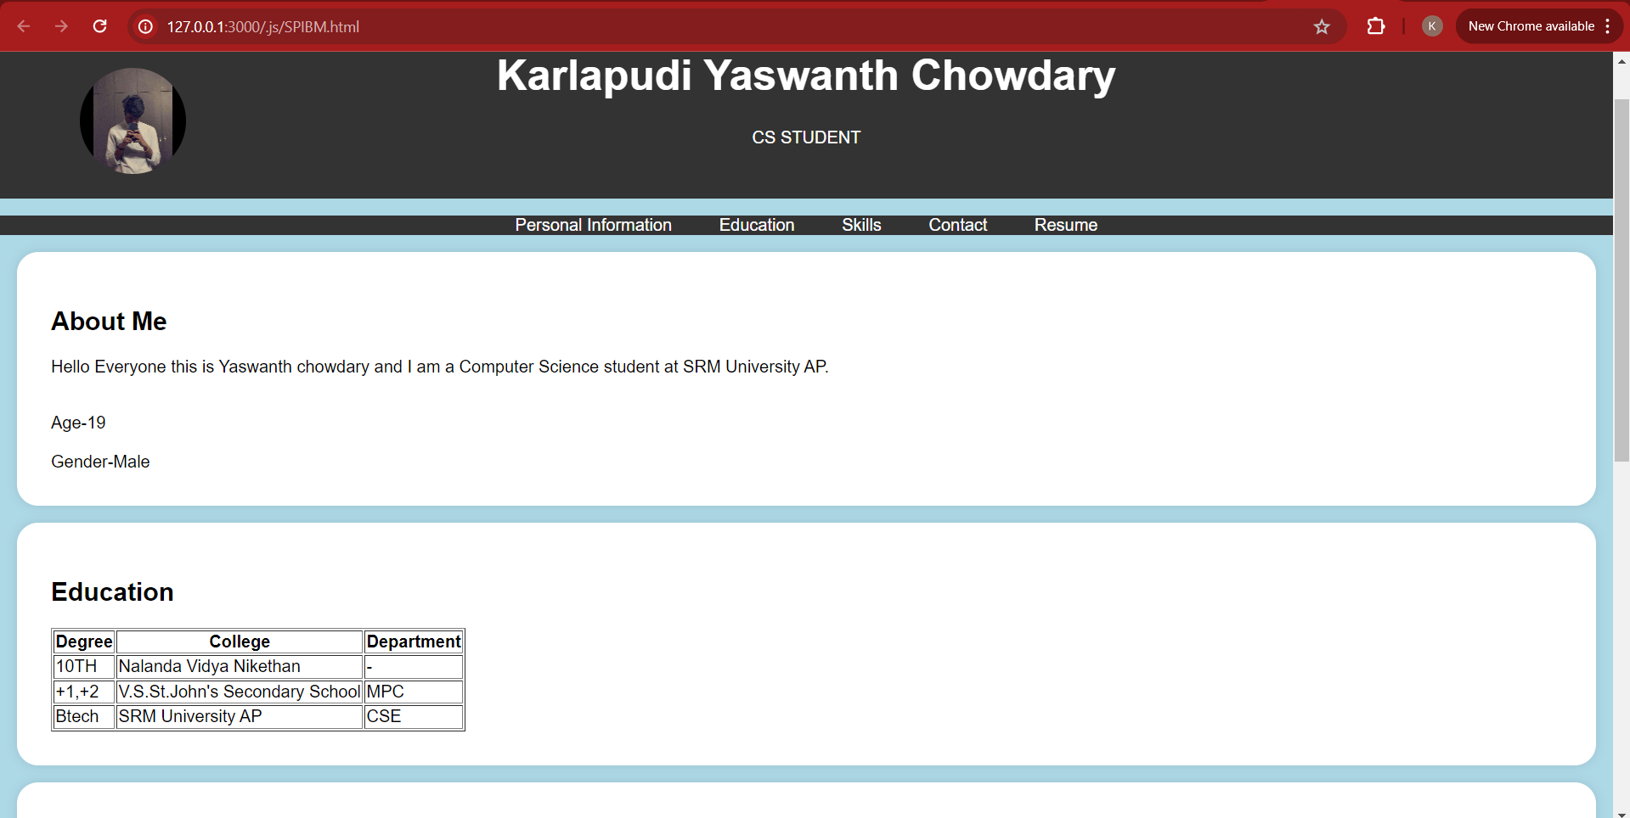
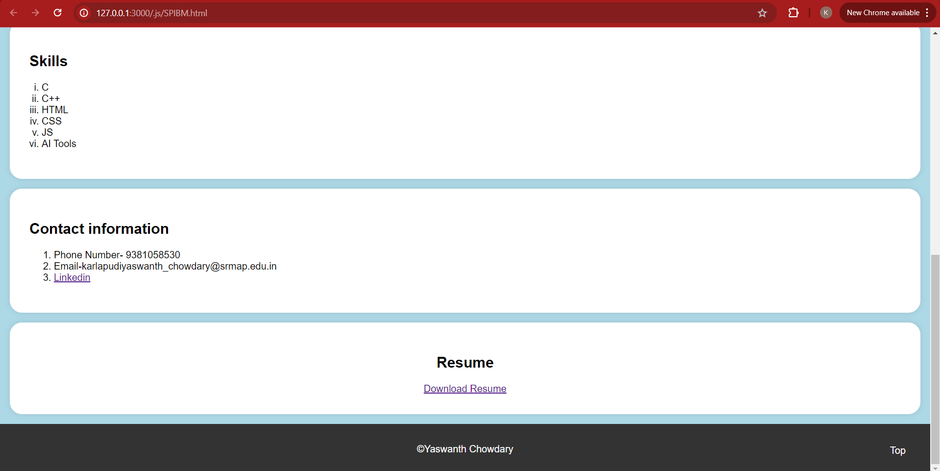
results

Slide 10
links
W3 schools:- https://www.w3schools.com/html/html_scripts.asp
Github link :-https://github.com/Yaswanthkarlapudi/FED---STUDENT-PORTFOLIO.git

